Slide 1


R and Larg(ish) Data A Very Basic Introduction
John Wainwright
BSG Training Course, Windsor
December 2025
https://github.com/john-wainwright/RAndData

Slide 2
Some output from R
Wainwright J, G Ayala 2021 ‘Reconstructing the Neolithic River Çarşamba and the riverscape of Çatalhöyük, Turkey’, The Holocene 32(11), 1277–1304. doi: 10.1177/09596836211041744

Slide 3
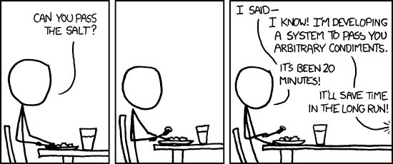
Why code?

Slide 4
Outline
FAIR
File reading and writing
R basics
Libraries
Graphics
Example script:
windsoRscript.R
Get the script and the data files from:
https://github.com/john-wainwright/RAndData

Slide 5

Data management
“Good data management is not a goal in itself, but rather is the key conduit leading to knowledge discovery and innovation, and to subsequent data and knowledge integration and reuse by the community”
Wilkinson et al (2016)
4 foundational principles:
https://www.go-fair.org/fair-principles/

Slide 6
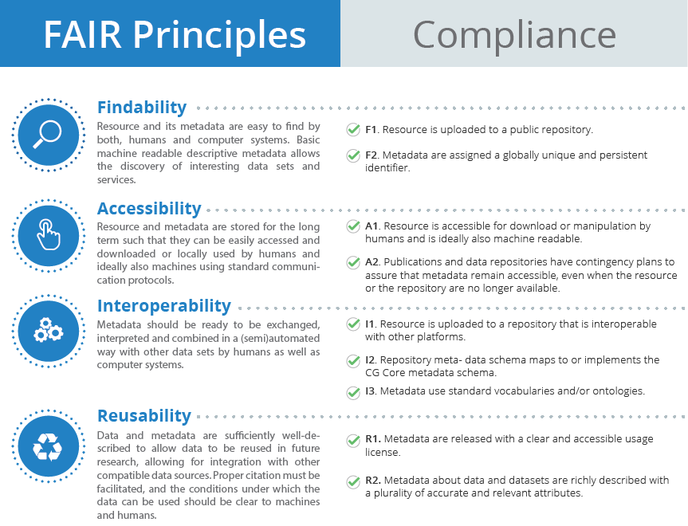
Source: https://ccafs.cgiar.org/open-access-and-fair-principles

Slide 7

Data files
DurhamWeather1850_2025.csv
Mean Central England Temperature 1659 to 2024: meantemp_seasonal_totals.txt (https://www.metoffice.gov.uk/hadobs/hadcet/)
Monthly England & Wales precipitation 1766 - 2024: HadEWP_monthly_totals.txt (https://www.metoffice.gov.uk/hadobs/hadukp/)
https://durhamweather.webspace.durham.ac.uk/open-access-climate-datasets/

Slide 8
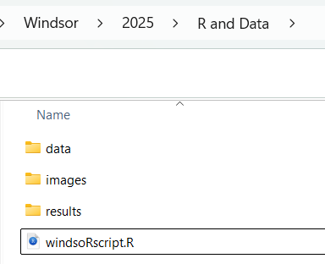
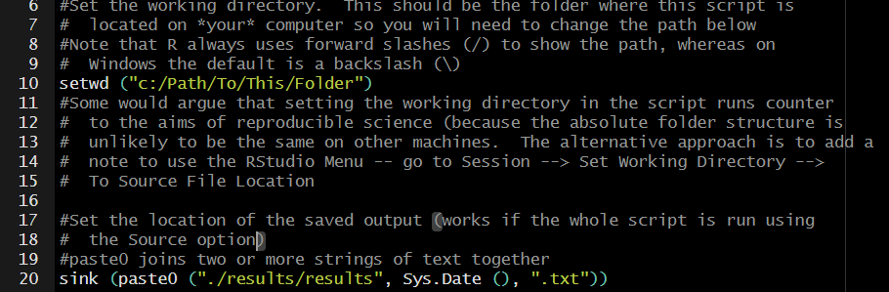
Data management
Your data should be kept separate from any output and the scripts used to produce that output
The script assumes that there are three folders that must be in the relative locations shown on the left
Change this line to point to the location of the script on your computer
(but note the comment about reproducibility
sink (filename) copies the console output to the file – here the filename is also given the date to keep track of changes

Slide 9
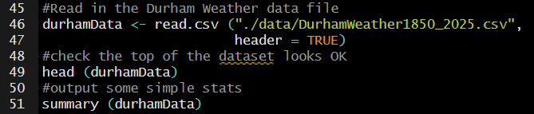
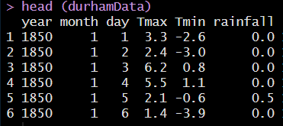
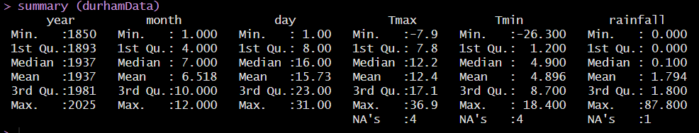
Reading and checking data
In the Environment pane in Rstudio, you should see we now have 64222 observations of 6 variables:
year, month, day
Tmax, Tmin
rainfall
Note there are missing values

Slide 10
R basics

Slide 11
Variables
Note the preferred use of <- to assign values in R
Types
Conversion to type
Integer a <- 1
Numeric a <- 1.0
Characters a <- ‘1’
Factors a <- factor (1)
Boolean a <- TRUE
as.integer ()
as.numeric ()
as.character ()
as.factor ()
as.logical ()
Think of factors as grouping variables. They become important in certain types of statistical analysis

Slide 12
Functions
Combine function: c (“John”, “Wainwright”), c (1, 2)
Statistical functions: mean (a), mean (a, na.rm = TRUE)
Mathematical functions: exp (a), log (a)
Combinations of functions: mean (exp (a))
(parentheses are important to define precedence)
Help!

Slide 13
Data Frames
The basic data structure in R is a data frame, i.e. columns of variables with rows for each observation
data.frame () creates a data frame from scratch
We have just created a data frame using the read.csv () function
Click on the name of the data frame in the Environment Pane or type View (data_frame_name) to see what it contains. Note that you cannot (for good reason) edit the data in the data frame here
To access the columns, use $column_name or [column number] or [“column_name”]
To access the rows, use [row_number, ]
To access any element, use [row_number, column_number] (but note having to do this can be avoided in most cases, which speeds things up a lot)
Note the difference between a data frame, an array, a matrix and a list. Advanced R has many different types of data structure

Slide 14
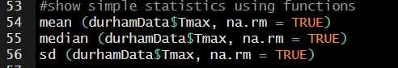
Use of functions
Base R has a range of functions for simple statistics
Note that if there are missing values in the data, R will default to saying the overall result is a missing value, unless we tell it to ignore the missing values using na.rm = TRUE (type mean (durhamData$Tmax) into the console to see this is the case)
To see what’s in the base and stats libraries in R, you can type in the console:
> library (help = "base")
> library (help = "stats")
These libraries are always available without an extra library call

Slide 15
Libraries

Slide 16
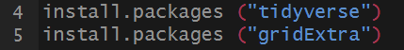
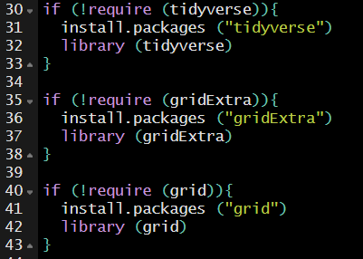
Libraries
R is an extensible language, making it extremely powerful and flexible
Extra functions are stored in Libraries, installed from packages on CRAN (or elsewhere)
In our test script we used:
To install the tidyverse and gridExtra packages from CRAN
We tell our current script that we want to use the installed libraries with:
(actually, all we need are the library () lines, but I’ve put an extra tweak in to promote reproducibility)

Slide 17

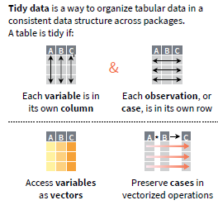

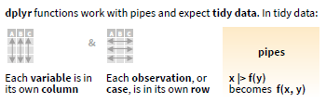

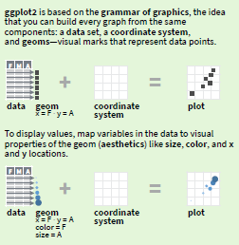
The tidyverse
tidyr
dplyr
ggplot2

Slide 18

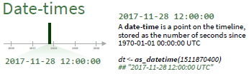
The tidyverse (cont.)
Let’s apply dplyr and lubridate to create a new variable called date:
%>% is the pipe – it sends the dataset as the first argument to the next function (mutate here)
mutate is a dplyr function to create a new variable (column)
make_date (year, month, day) is a lubridate function to combine separate values into a single date-time

Slide 19
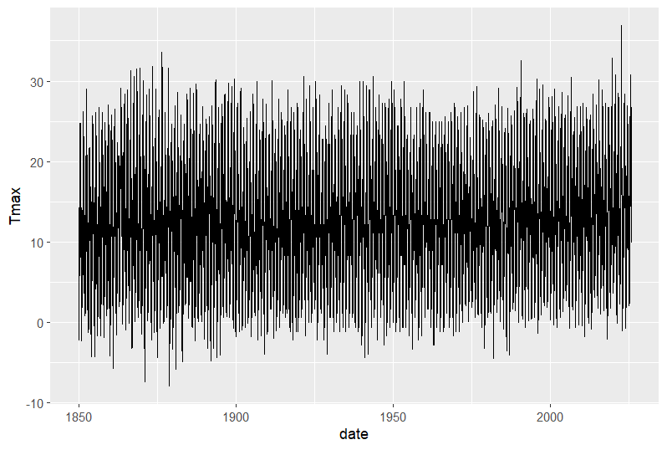
Plotting
To make a simple plot, we call ggplot with a reference to the data to be used
geom_line gives the aesthetics (aes) of the x and y data
Each component of the plot is added to the previous one using +
The graph should appear in the Plots pane in Rstudio. You can save it from there (though we’ll see later that there’s a better method) or copy it to the clipboard

Slide 20
Data Wrangling

Slide 21
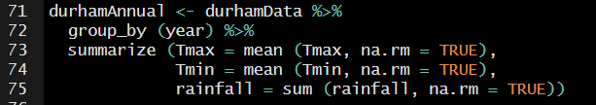
dplyr
The previous graph contained all the data, but it’s not easy to work out what’s happening. Let’s use dplyr to calculate annual statistics to simplify things
So we now have a new data frame called durhamAnnual
We use group_by () to tell R we want grouped data
And summarize () does the calculations for each of these groups
durhamAnnual now has 176 observations – one for each year in the dataset

Slide 22
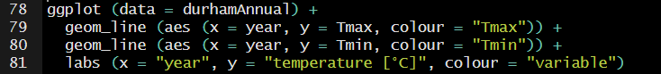
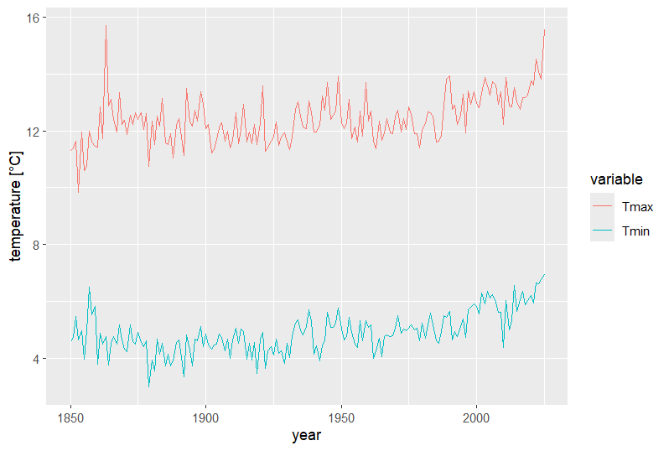
More ggplot
Passing a value to a colour aesthetic causes ggplot to choose a colour and generate a legend
Again, let’s check the output by plotting:
We can adjust the labels of the axes and the legend
Something odd seems to be happening at the end of the plot

Slide 23
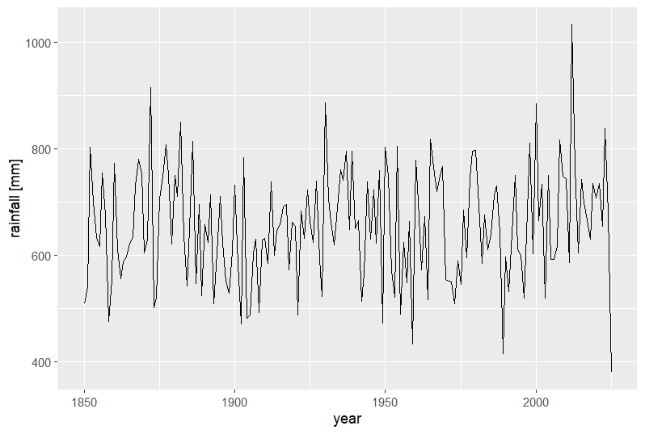
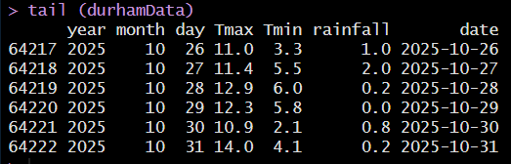
It’s even more obvious in the rainfall plot, so let’s look at the data at this point using the tail () function
Our original data only continue to the end of October 2025, causing the issues with the statistics for that year

Slide 24
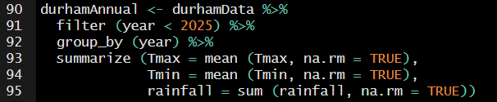
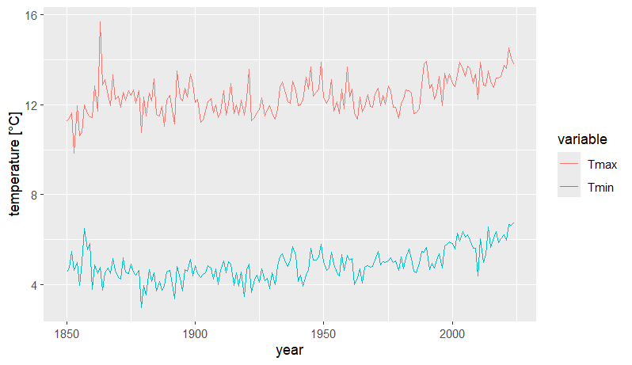
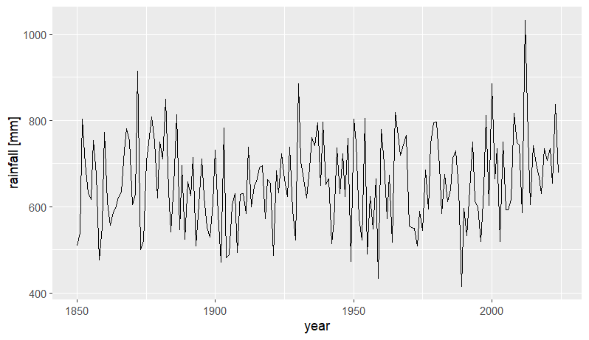
dplyr again
Luckily, there’s a relatively easy fix: we can use filter () from dplyr to avoid calculations for the last year
So when we repeat the plots:

Slide 25
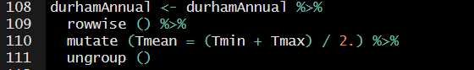
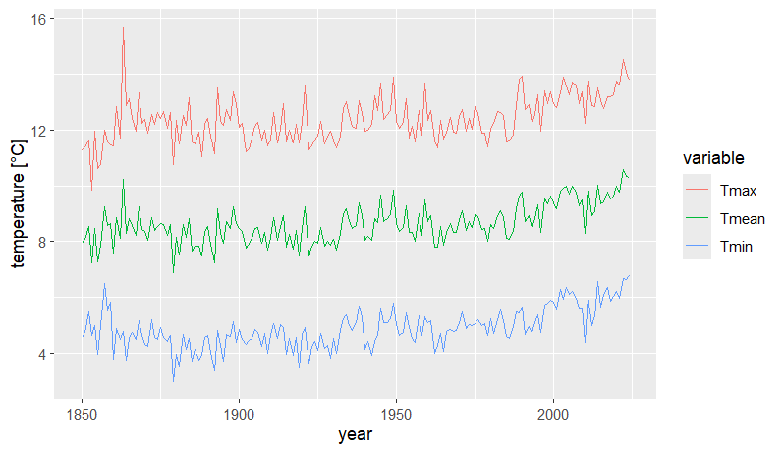
We need to take a slightly different approach to calculate the mean temperature, as the calculation is across the rows rather than by group:
rowwise () tells dplyr to do the following calculations on a row-by-row basis
ungroup () stops rowwise ()
Note how we’ve built up the data wrangling step-by-step
In this step, we’ve taken then durhamAnnual data from the previous step, done the rowwise calculation, and saved the whole thing back into durhamAnnual
And we can add the mean temperatures to our plot as before

Slide 26
So How does Durham Compare to Other Long Sequences?

Slide 27
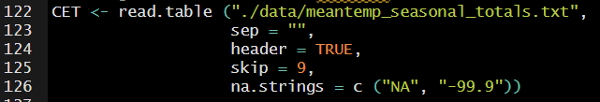
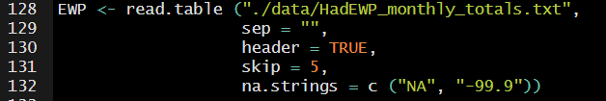
Datasets
The Hadley Centre maintain the Central England Temperature record (originally developed by Gordon Manley) which dates back to 1659 and is the oldest instrumental record available worldwide (https://www.metoffice.gov.uk/hadobs/hadcet/)
There is also an England and Wales precipitation data series going back to 1766 at (https://www.metoffice.gov.uk/hadobs/hadukp/)
There’s a header with the variable names
Don’t read in the metadata at the top of the file
These files are space separated, so we use read.table with sep = “”
We want missing data to be seen as missing, not the coded values
Note that sep = "" looks for any number of white spaces; sep = " " would only look for a single white space
There are metadata at the top of the file, that we want to be ignored when reading the data
We want missing data to be seen as missing, not the coded values

Slide 28
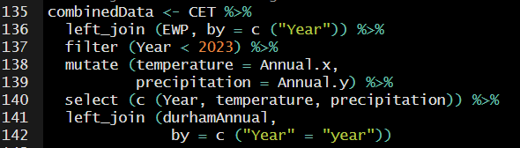
Combining the Datasets
dplyr can easily join datasets where there are matching variables – in this case the year:
Both the CET and EWP have a variable called Year
left_join () takes the values from the first dataset and matches to the same values in the second dataset
The Durham dataset has the year variable but it’s all lower case – so we need to tell left_join () about how to map them
The CET and EWP both use the variable name Annual, but they mean different things, so let’s use mutate () to make more sense of them
We only want to use the annual data, so let’s save space by just keeping those variables in the combined dataset

Slide 29
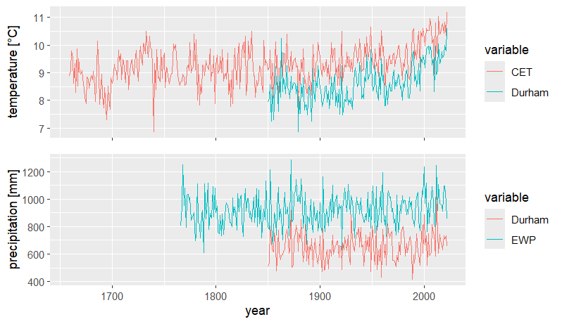
Combining Plots

Slide 30
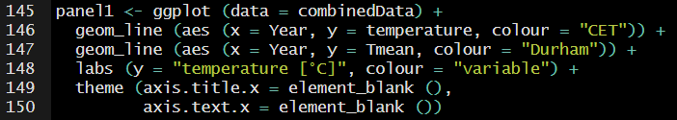
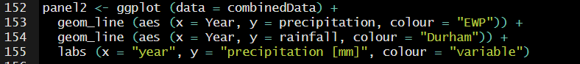
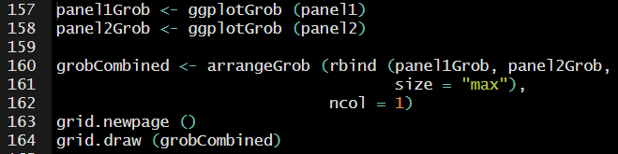
Combining Plots
Create panels for each of the plots
Convert the panels into graphics objects (Grobs)
Combine the Grobs
Plot the Grobs using the grid library

Slide 31
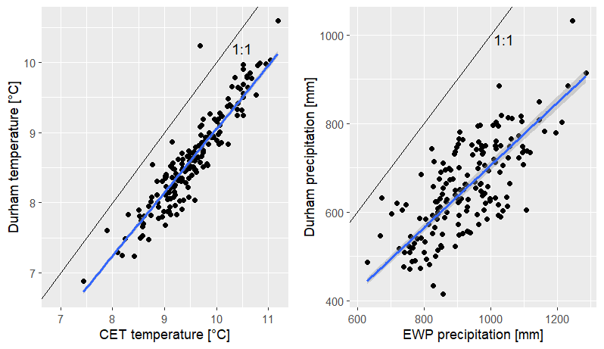
Combining Plots

Slide 32
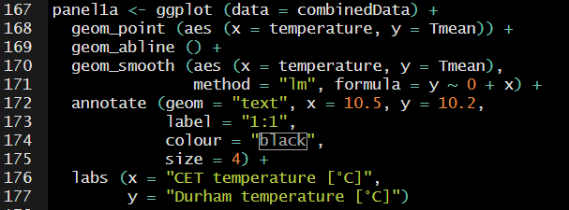
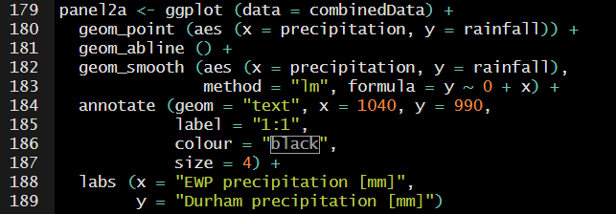
Combining Plots
annotate ()
geom_abline ()
geom_point ()
geom_smooth ()

Slide 33
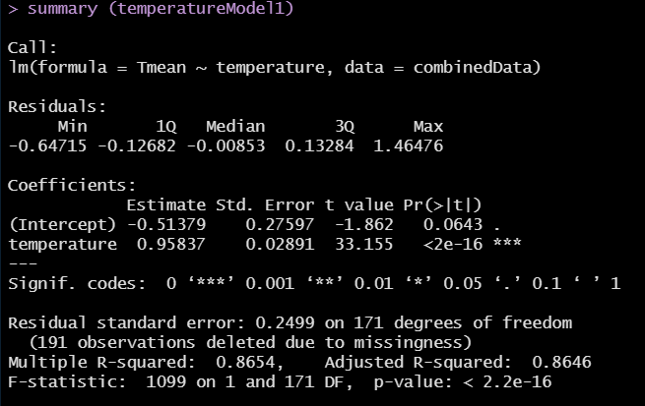
Making Predictions
lm () fits a linear model to the dataset
Save it to an object and output the object using summary ()
We specify the model to fit using a tilde ~ (read the tilde as “as a function of”)
In this case, the intercept term is not significant
Explained variance
But the overall model is significant

Slide 34
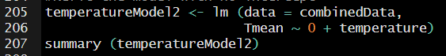
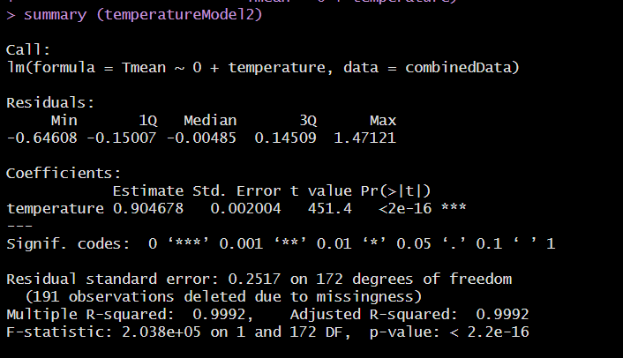
Fitting without an Intercept
Force the model through the origin using y ~ 0 + x

Slide 35
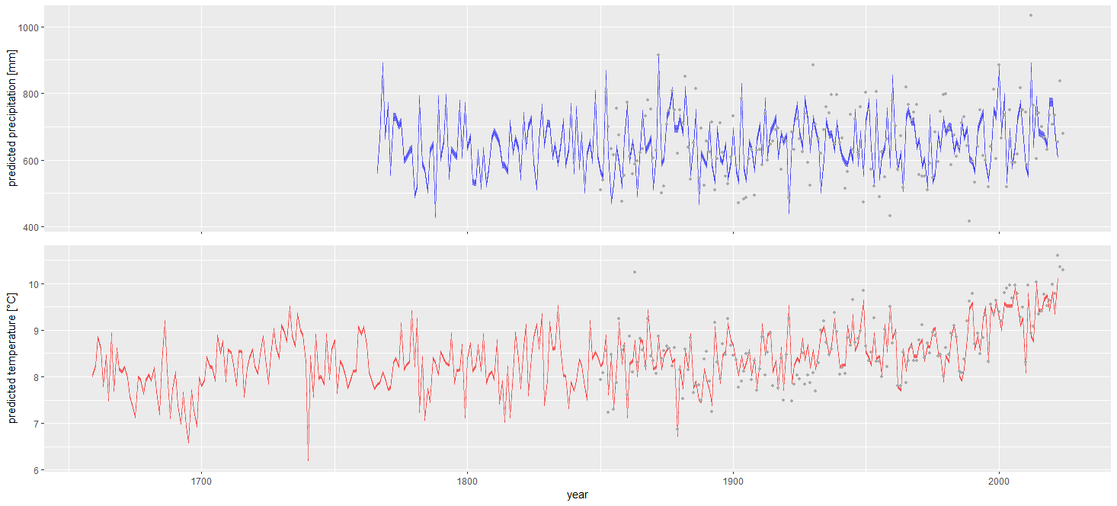
Making Retrodictions

Slide 36
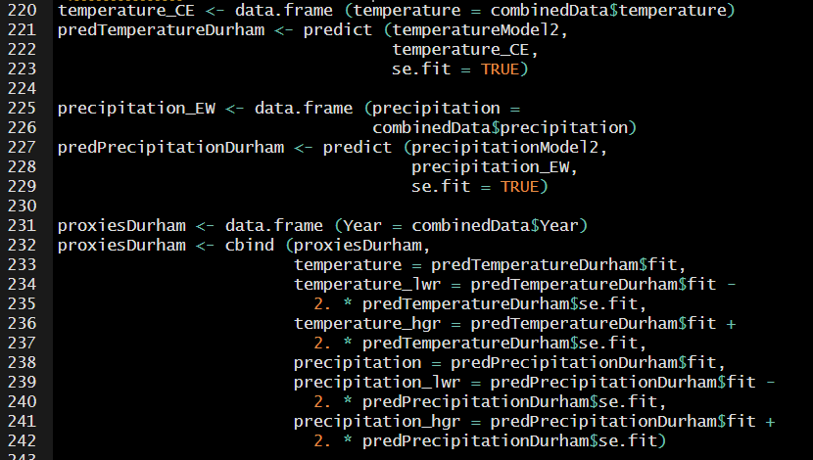
Making Retrodictions
Get the CET temperature data to make the predictions
Use the predict function to take the model object generated using the CET temperature and fit the uncertainty
Generate a new data frame with the proxy data …

Slide 37
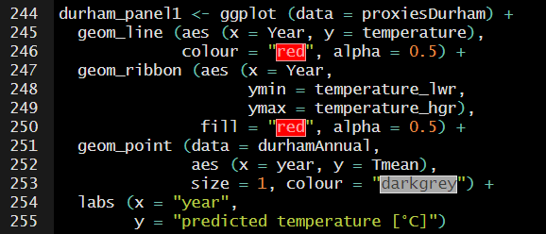
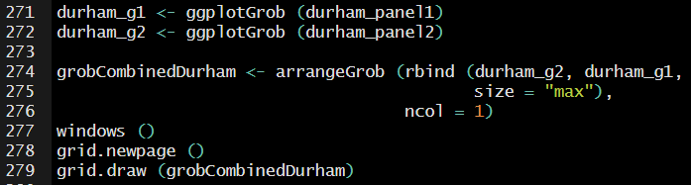
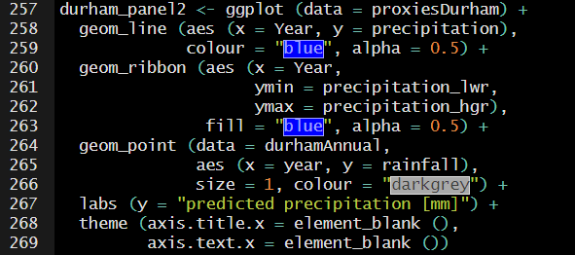
Making Retrodictions
windows () creates a new window to put the plot into

Slide 38
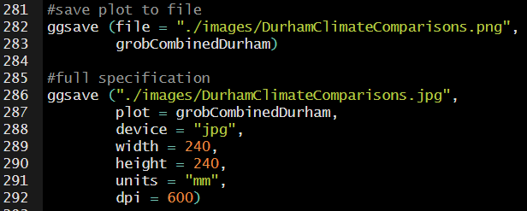
Saving Graphs to File
File type can by specified based on extension only
Or full specification can be given including resolution and size
For simple plots (not grobs), ggsave (filename) will save the last plotted graph to file

Slide 39
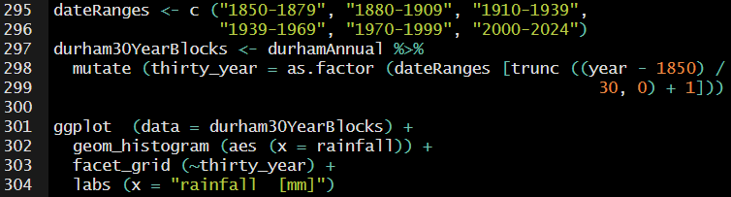
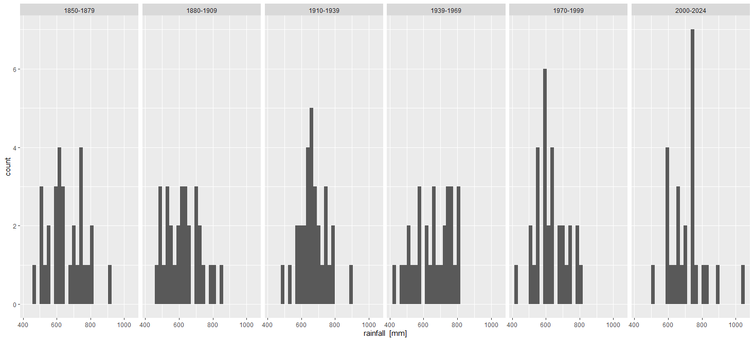
Climate Change?
Set up names of 30-year blocks and use mutate to set up a new variable with them
geom_histogram () draws a histogram
facet_grid (~variable) draws one geometry per value of the variable

Slide 40
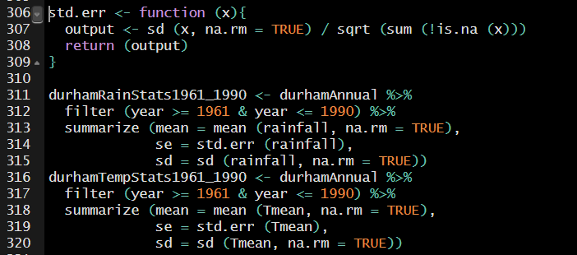
Compare with Baseline
It’s simple to set up our own functions for repeated actions or calculations
Input(s) to the function are given in the opening parenthesis
Any object can be return: a single value, data frame …
Once function () has been run, the new function can be used in calculations in the same way base R functions or library functions are
New function to calculate the standard error of a variable
The function can be used in the same way as any built-in function

Slide 41
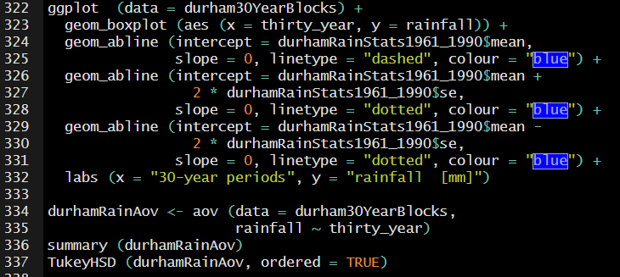
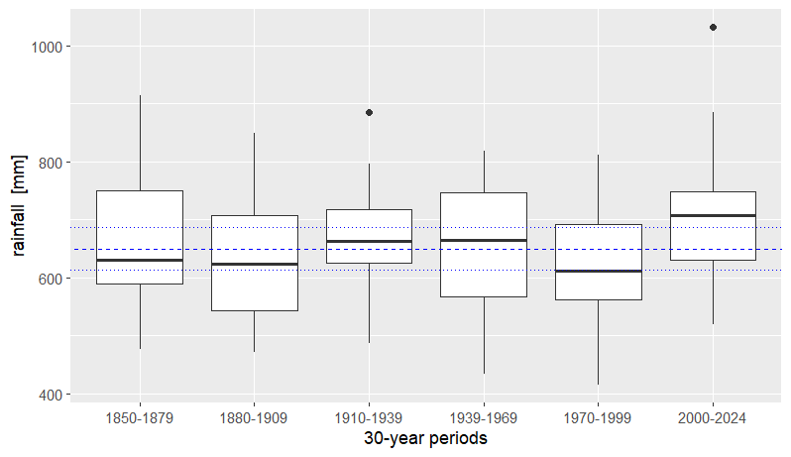
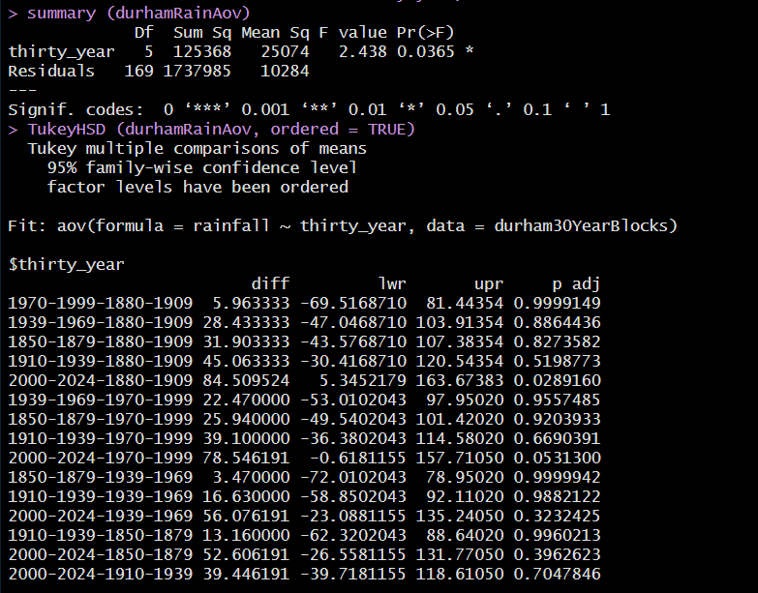
Climate Change?
aov (data, formula) calculates analysis of variance (note the similarity of the approach with that of lm ()
TukeyHSD (aov_model) calculates the Tukey Honest Significant Difference for a multiple comparison based on the analysis of variance results

Slide 42



Climate Change?
aov (data, formula) calculates analysis of variance (note the similarity of the approach with that of lm ()
TukeyHSD (aov_model) calculates the Tukey Honest Significant Difference for a multiple comparison based on the analysis of variance results

Slide 43
Some Closing Thoughts (1)
sink () on its own turns any output off
Scripts / Procedural approach to programming / coding
#comments are your friend!
#Longer comments are also your friend (list variables, methods # etc. – don’t assume you will remember later!)
Use informative variable names (don’t assume you will remember what they mean later!)
There are LOTS of R resources out there – both to find out how to do something and what to do if something’s gone wrong. Always look first on your favourite search engine!
Stackoverflow is an excellent resource

Slide 44
Some Closing Thoughts (2)
Some useful resources for your next steps:
H Wickham, M Çetinkaya-Rundel, G Grolemund (2024) R for Data Science (2nd edition): https://r4ds.hadley.nz/
TM Davies (2016) The Book of R: https://web.itu.edu.tr/~tokerem/The_Book_of_R.pdf
E Paradis (2005) R for Beginners: https://cran.r-project.org/doc/contrib/Paradis-rdebuts_en.pdf
And many, many more!
Not forgetting cheatsheets …

Slide 45

Cheatsheets
Number of examples copied into the repository from Posit and other sources
Search for R cheatsheets!

Slide 46


